Slide 1

Verification of Size Invariance in DNN
Activations using Concept Embeddings
CogSys Colloquium 2021-03-25, Gesina Schwalbe
Notes:
What?
Most of it in a paper submitted to AIAI 2021

Slide 2
Agenda
Background & Motivation
Part I: Improving State-of-the-art
Part II: Exemplary Verification of Properties
Notes:
Motivation: Why and for what one would consider CA and what still was to do

Slide 3

Background: Need for XAI
Setting: DNN with safety load
Goal: Inspect / test / formally verify rules about object parts
e.g. Heads are usually part of Pedestrians
$∀ x:\text{is}\text{Head}\left(x\right)→\left(∃ p:\text{is}\text{Pedestrian}\left(p\right)∧\left(x \text{isPartOf} p\right)\right)$
(Neumann et al. 2018), p. 7, Fig. 2
Visual semantic concepts
= 1-ary predicates on image (region)
(Xiao et al. 2018), p. 6, Fig. 3
Notes:
Verification methods for traditional SW:
Inspection
formal requirements for test case derivation & formal verification
DNNs: Black-box!!

Slide 4
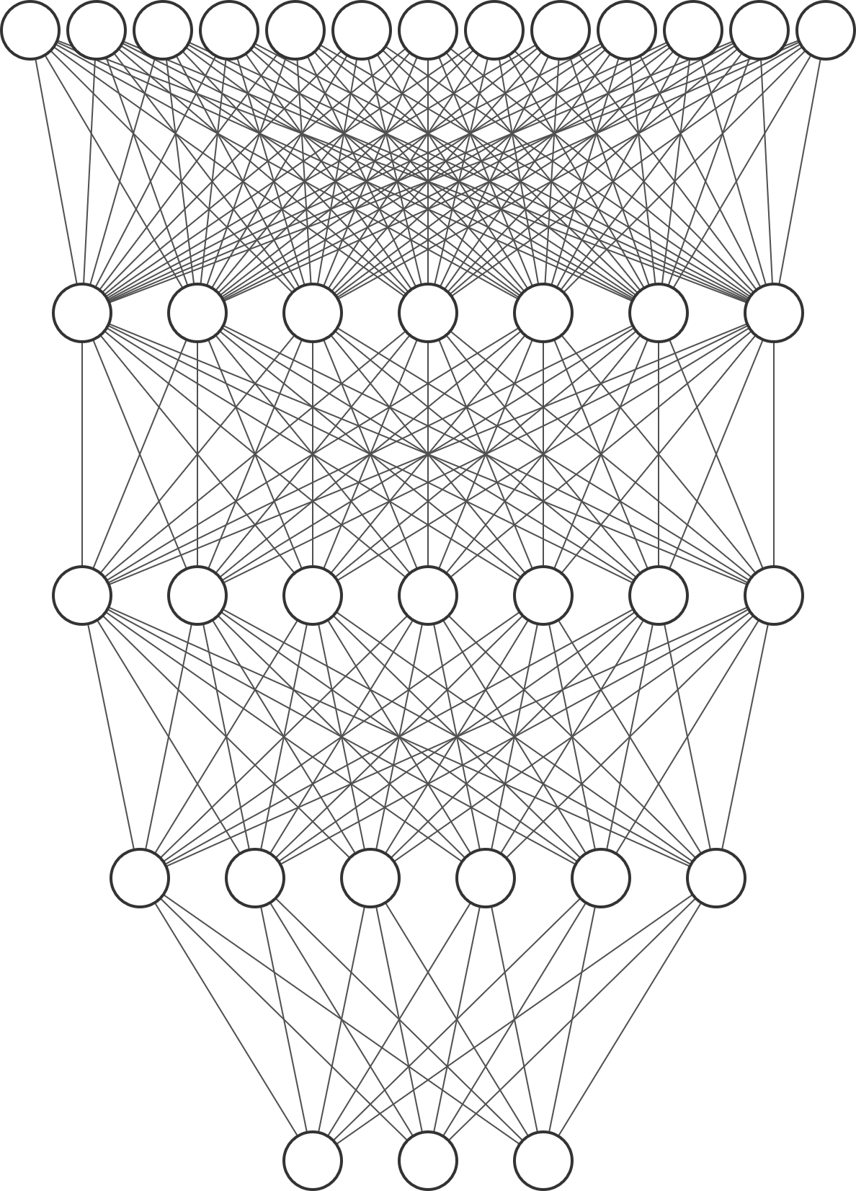
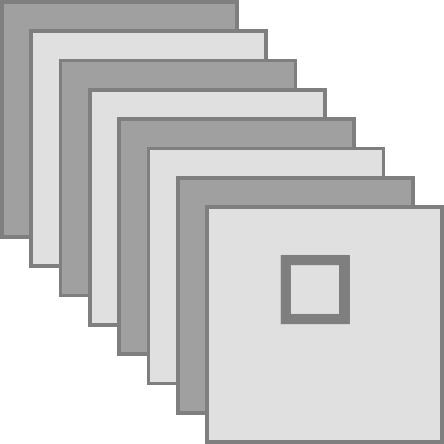


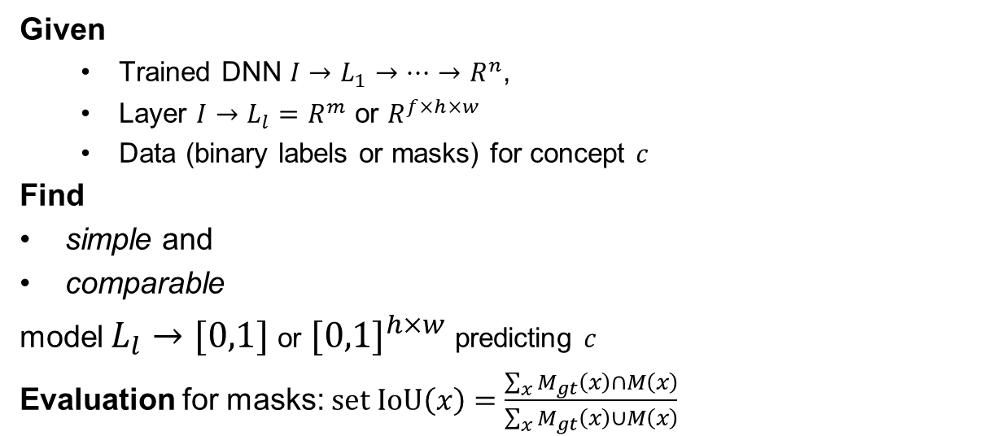
Background: Concept Analysis (CA)
Given
  Trained DNN $I→L_{1}→…→R^{n}$,
  Layer $I→L_{l}=R^{m}$ or $R^{f×h×w}$
  Data (binary labels or masks) for concept $c$
Find
simple and
comparable
model $L_{l}→[0,1]$ or ${[0,1]}^{h×w}$ predicting $c$
Evaluation for masks: $\text{set} \text{IoU}\left(x\right)=\frac{\sum_{x}{M_{gt}\left(x\right)∩M\left(x\right)}}{\sum_{x}{M_{gt}\left(x\right)∪M\left(x\right)}}$
or
prototype (Ghorbani et al. 2019)
or linear (Kim et al. 2018), (Fong and Vedaldi 2018)
Pedestrian (at)?
Head?
or
Head at?
Notes:
Why simple and what does simple mean?
Must be easily interpretable
→ More interpretable
We want to directly investigate the model representation space.
→ No major changes to model!
What does comparable mean?
Semantic relations translate to relations on model (e.g. L_2 distance of weights <-> concept similarity)
Why to choose linear models?
→ Behave like word vector space → vector operations correspond to semantic relations

Slide 5

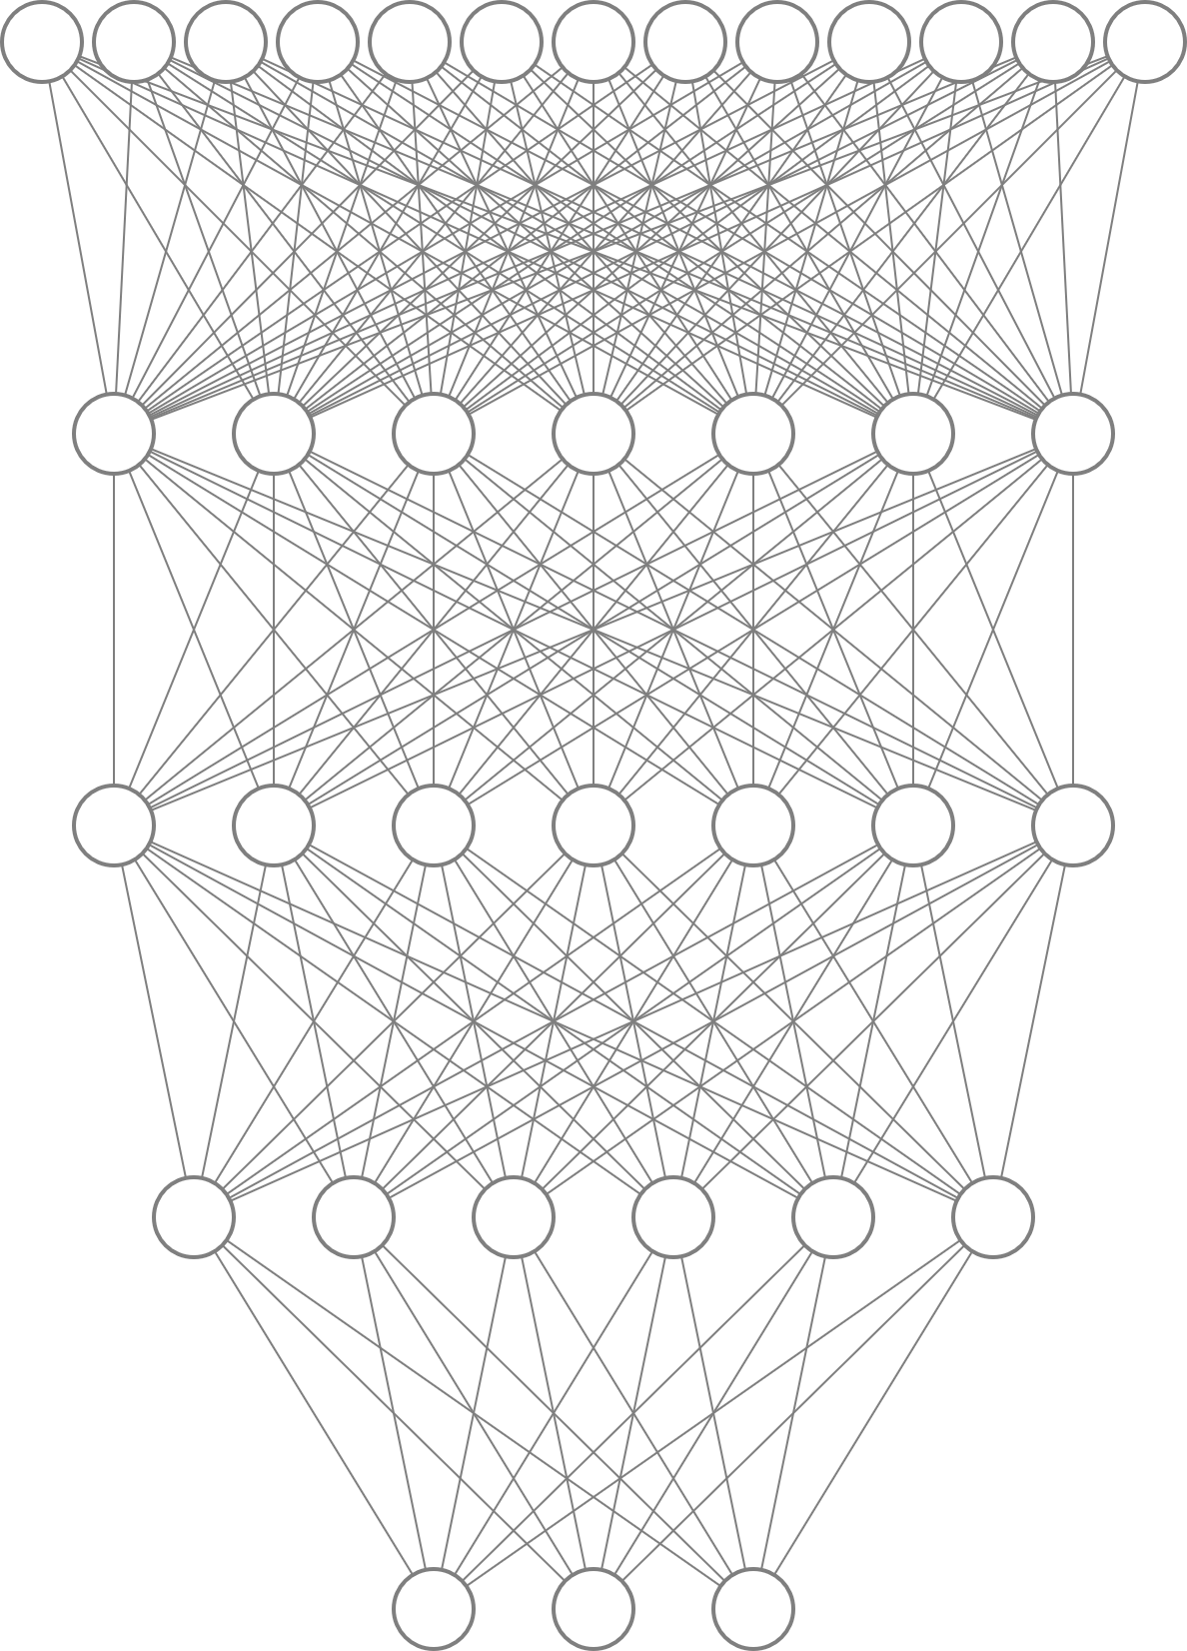








Background: Concept Analysis (CA)
$$\text{concept} \text{model}$$
My concept model:
My concepts:
body parts
$$=$$
$$⋅w_{c}+b_{c}$$
$$\text{upscaling}$$
$$\text{sigmoid}$$
$$ground truth \\ \text{for} c\text{ = "}\text{head}\text{"}$$
$$prediction$$
$$\text{main} \text{task}$$
$$"\text{head}" at …$$
cf. (Fong and Vedaldi 2018)
Notes:
Interesting:

Slide 6
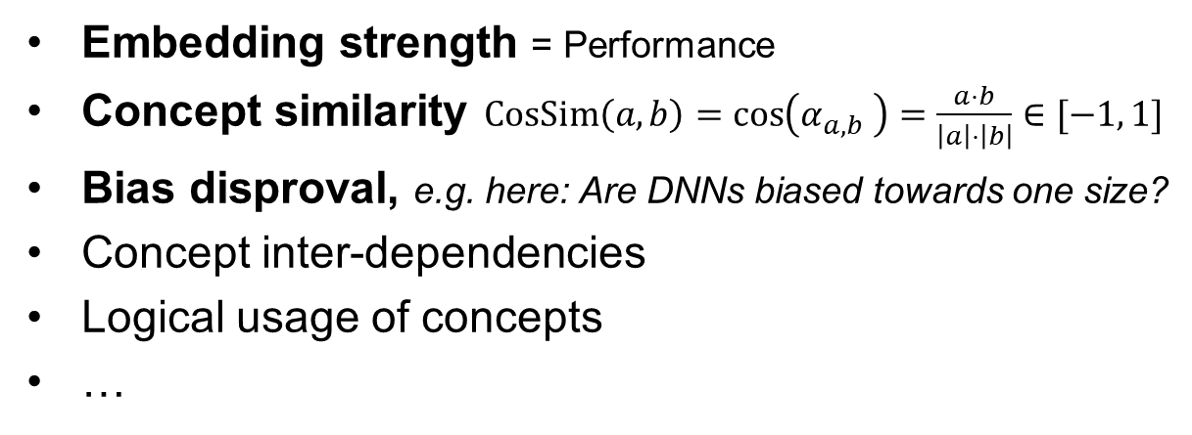
CA for Verification: Offline use-cases
Embedding strength = Performance
Concept similarity $\text{CosSim}\left(a, b\right)=\cos\left(α_{a,b} \right)=\frac{a⋅b}{\left|a\right|⋅\left|b\right|}∈[−1, 1]$
Bias disproval, e.g. here: Are DNNs biased towards one size?
Concept inter-dependencies
Logical usage of concepts
…
Notes:
Nice things one should in principle be able to do

Slide 7
Agenda
Background & Motivation
Part I: Improving State-of-the-art
Part II: Exemplary Verification of Properties
Notes:
Motivation: Why and for what one would consider CA and what still was to do

Slide 8
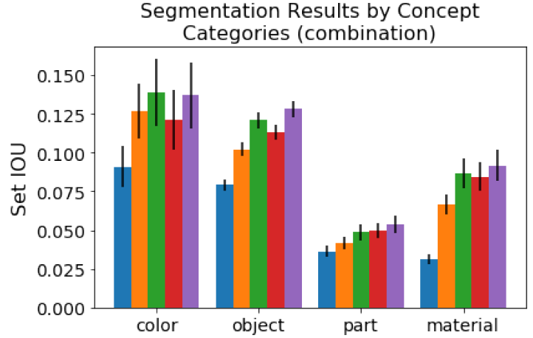
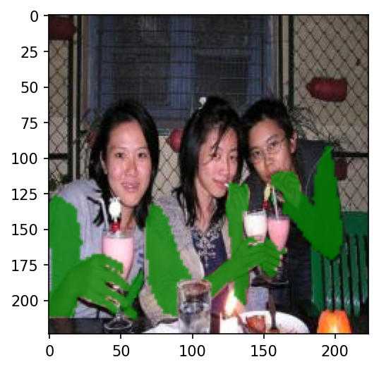
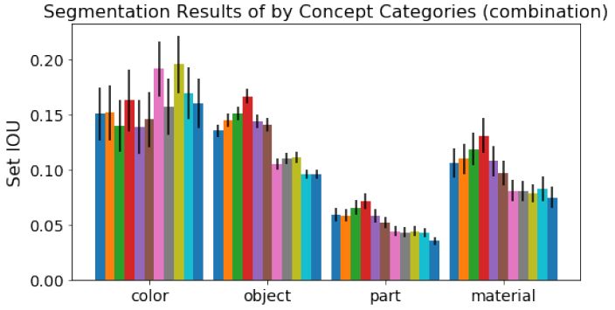
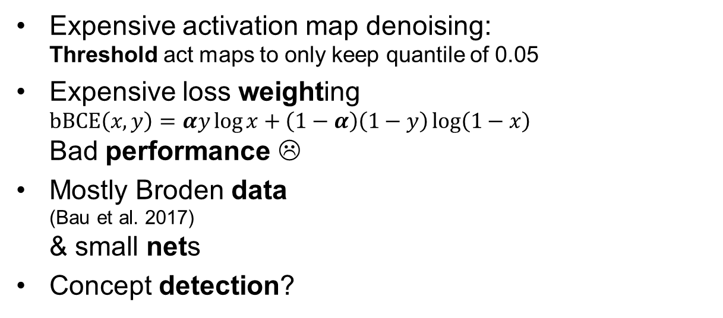
The Problem(s)
Efficiency
Performance
Data
(Task)
Expensive activation map denoising:
Threshold act maps to only keep quantile of 0.05
Expensive loss weighting
$\text{b}\text{BCE}\left(x, y\right)=αy\log{x}+\left(1−α\right)\left(1−y\right)\log\left(1−x\right)$
Bad performance ☹
Mostly Broden data
(Bau et al. 2017)
& small nets
Concept detection?
5 AlexNet Conv Layers
(Fong and Vedaldi 2018), Fig. 2
“arm”
11 different nets (3 arch)
(Fong and Vedaldi 2018), Fig. 6

Slide 9
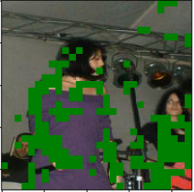
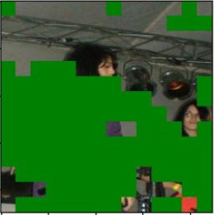
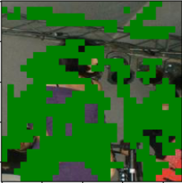
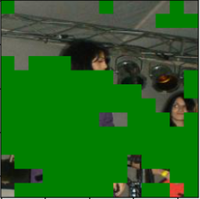
Improving State-of-the-art: Thresholding
Efficiency
Performance
Data
(Task)
Concept arm
VGG16, L22
VGG16, L29
Nets: VGG16, AlexNet
Data: Broden
with thresh:
No performance difference
without thresh:

Slide 10
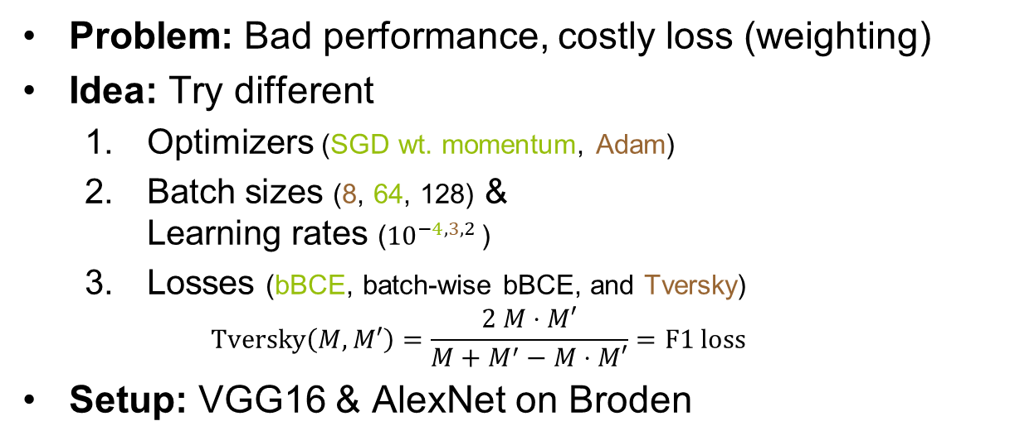
Improving State-of-the-art: Performance
Efficiency
Performance
Data
(Task)
Problem: Bad performance, costly loss (weighting)
Idea: Try different
  Optimizers (SGD wt. momentum, Adam)
  Batch sizes (8, 64, 128) &
  Learning rates (${10}^{−4,3,2 }$)
  Losses (bBCE, batch-wise bBCE, and Tversky)
  $\text{Tversky}\left(M, M′\right)=\frac{2 M⋅M′}{M+M^{′}−M⋅M′}=\text{F}\text{1 }\text{loss}$
Setup: VGG16 & AlexNet on Broden

Slide 11
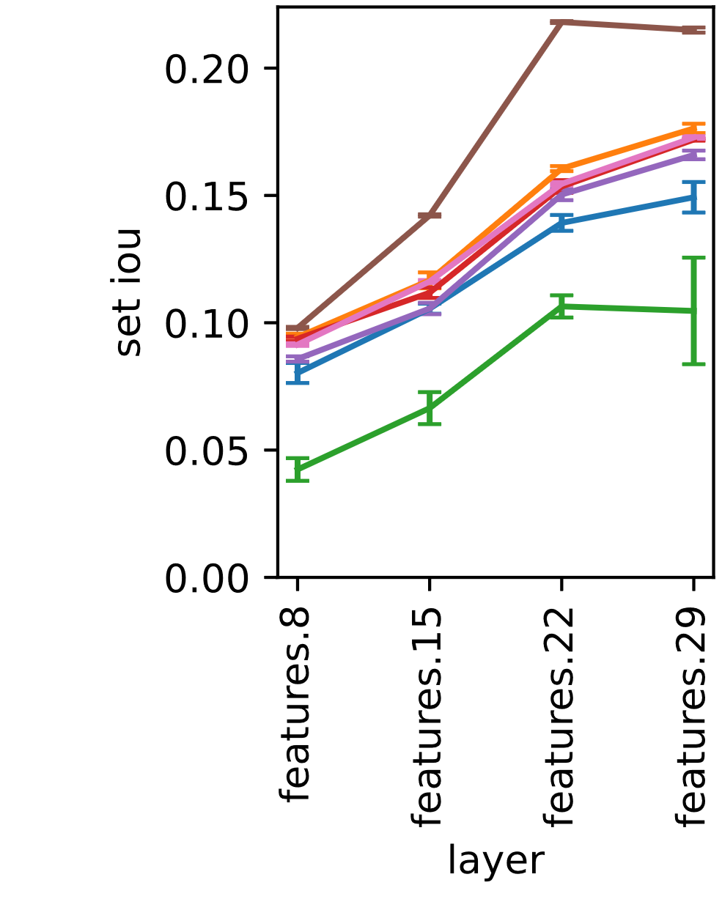
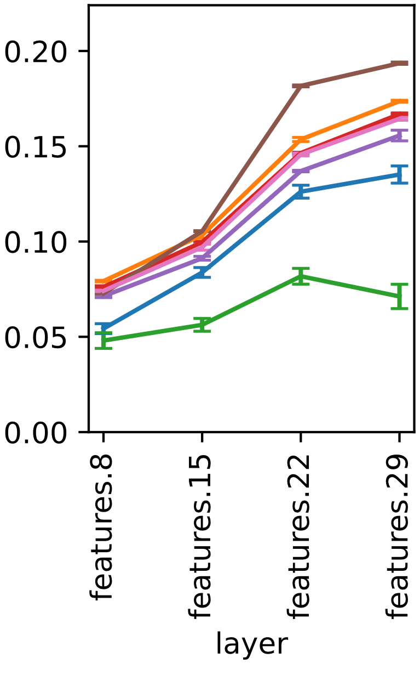
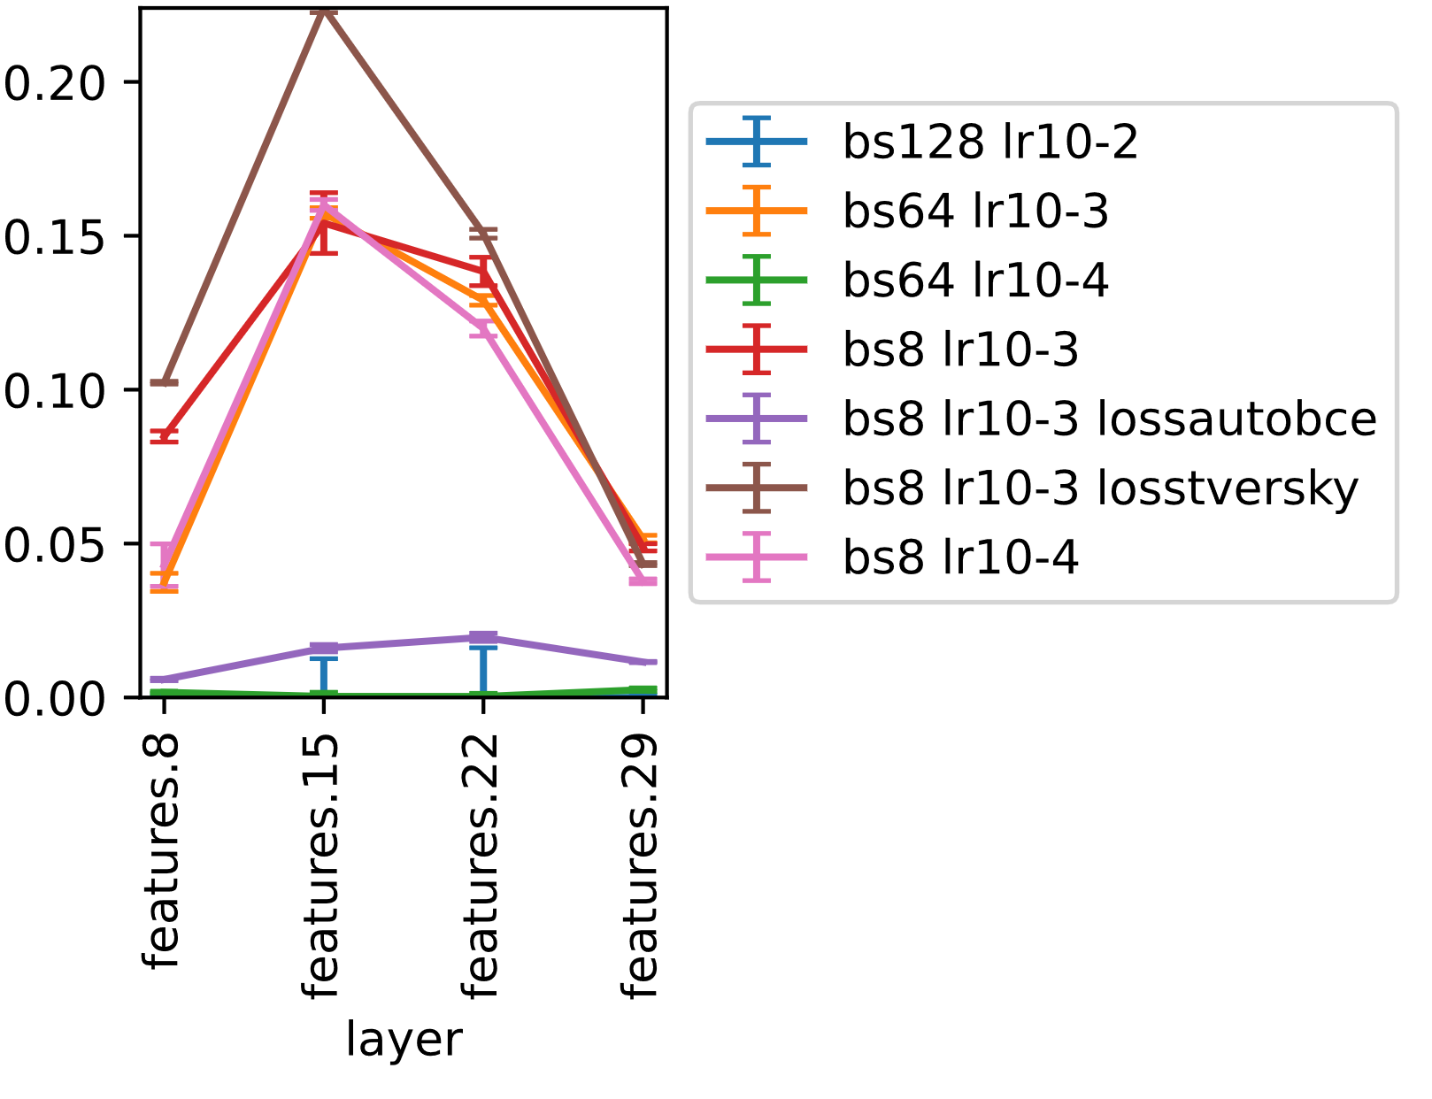
Improving State-of-the-art: Performance
Efficiency
Performance
Data
(Task)
VGG16:
arm
leg
eye
Notes:
What? Set IoU (performance) values per layer & concept for VGG16, for different settings
Original: green
Final chosen one: brown (Adam, bs 8, lr 10-3, F1-loss)
Note:
General boost
Boost on small concepts

Slide 12
Improving State-of-the-art: New Data based on MS COCO keypoints
Efficiency
Performance
Data
(Task)
Body part masks from MS COCO keypoints (Lin et al. 2014)
Notes:
Problem: Estimate total size in px for link width
Idea: Estimate via common proportions (assuming a standard height h=1,70m); sources:
Archeology
Arts
Schooling material

Slide 13
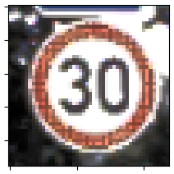


Improving State-of-the-art: Adaptive Kernels?
Efficiency
Performance
Data
(Task)
Possible problem: too small receptive field
→ Texture bias
Idea: Adaptive kernels
Results for
VGG16 & AlexNet on COCO:
unnecessary
Receptive field to predict one mask pixel:
Adaptive: $3×4$ conv
Net2Vec: $1×1$ conv
Notes:
Drawbacks: Concepts not comparable anymore!!

Slide 14
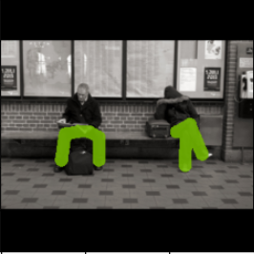
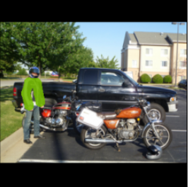
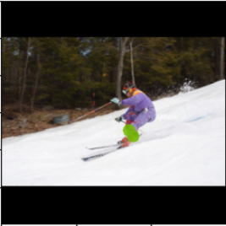
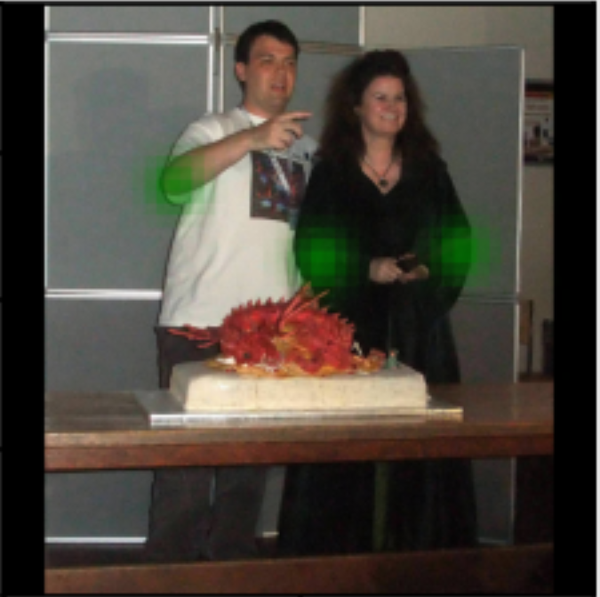
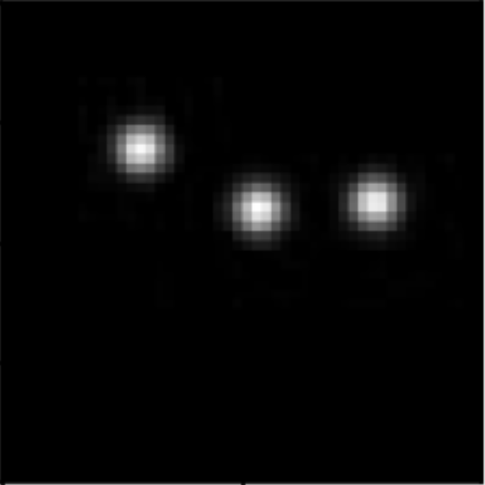
Improving State-of-the-art: Detection?
Efficiency
Performance
Data
(Task)
Segmentation
Problem:
Sometimes localization needed
→ Predict centers, not segmentation
Idea:
  Train to predict heatmap (=distribution)
  (KL Div, Focal Loss (Zhou et al. 2019))
  Peaks = center points
Results:
works fairly well
Heatmaps (@50x50 pixels)
Notes:
Drawbacks:
Masks dependent on layer size
How to deal with non-point concepts?

Slide 15
Agenda
Background & Motivation
Part I: Improving State-of-the-art
Part II: Exemplary Verification of Properties
Notes:
Motivation: Why and for what one would consider CA and what still was to do

Slide 16
CA for Verification
Emb. strenth
Similarity
Size bias
Embedding strength
Concept similarity
Size Bias disproval
Setup:
  AlexNet, VGG16, Mask R-CNN on MS COCO
  New Tversky-loss settings
Notes:
Reminder

Slide 17
CA for Verification: Embedding Strength
Emb. strenth
Similarity
Size bias
Mask R-CNN sample outputs:
Notes:
Very good results!
(More later)
Mask R-CNN: always >0.2, >0.3 for eye, arm, leg

Slide 18
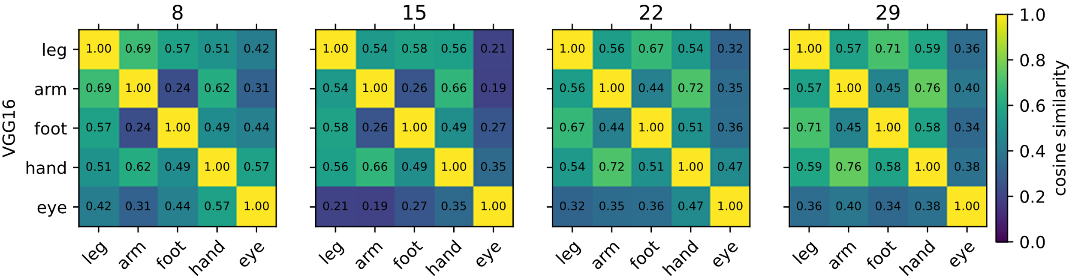
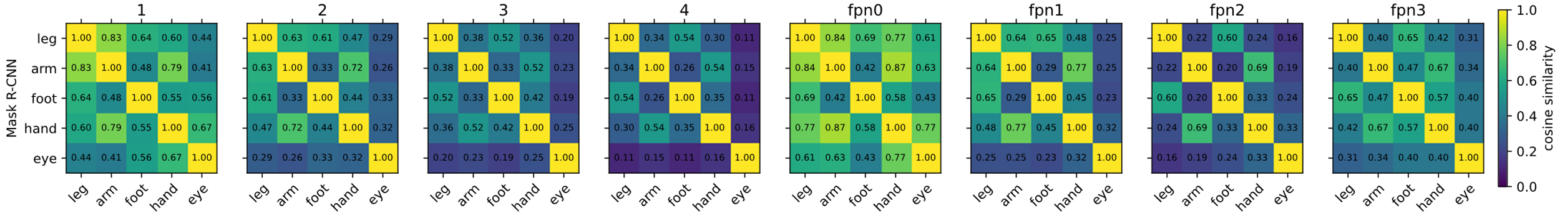
CA for Verification: Concept Similarity
Emb. strenth
Similarity
Size bias
Notes:
Cosine similarity between concept vectors in different layers
Top: VGG16, bottom: Mask R-CNN
Interesting:
None <0
Eye furthest from other
Hand ~ arm, foot ~ leg
Layers with high resolution brighter = less discriminative

Slide 19
CA for Verification: Size Bias
Emb. strenth
Similarity
Size bias
Is the model biased towards one size?
Check test performance on size sub-sets.
Check test performance when trained on sub-sets.
Check similarity between different training sets.
Notes:
CM trained on all data already biased towards a size?
Can training on subsets improve performance?
Relation between CMs on subsets and all data?
data biased <~ “all”-CM biased (more of embedding of this model in “all”)
model biased <=> one size better embedded
model biased => sizes yield unequal CM

Slide 20
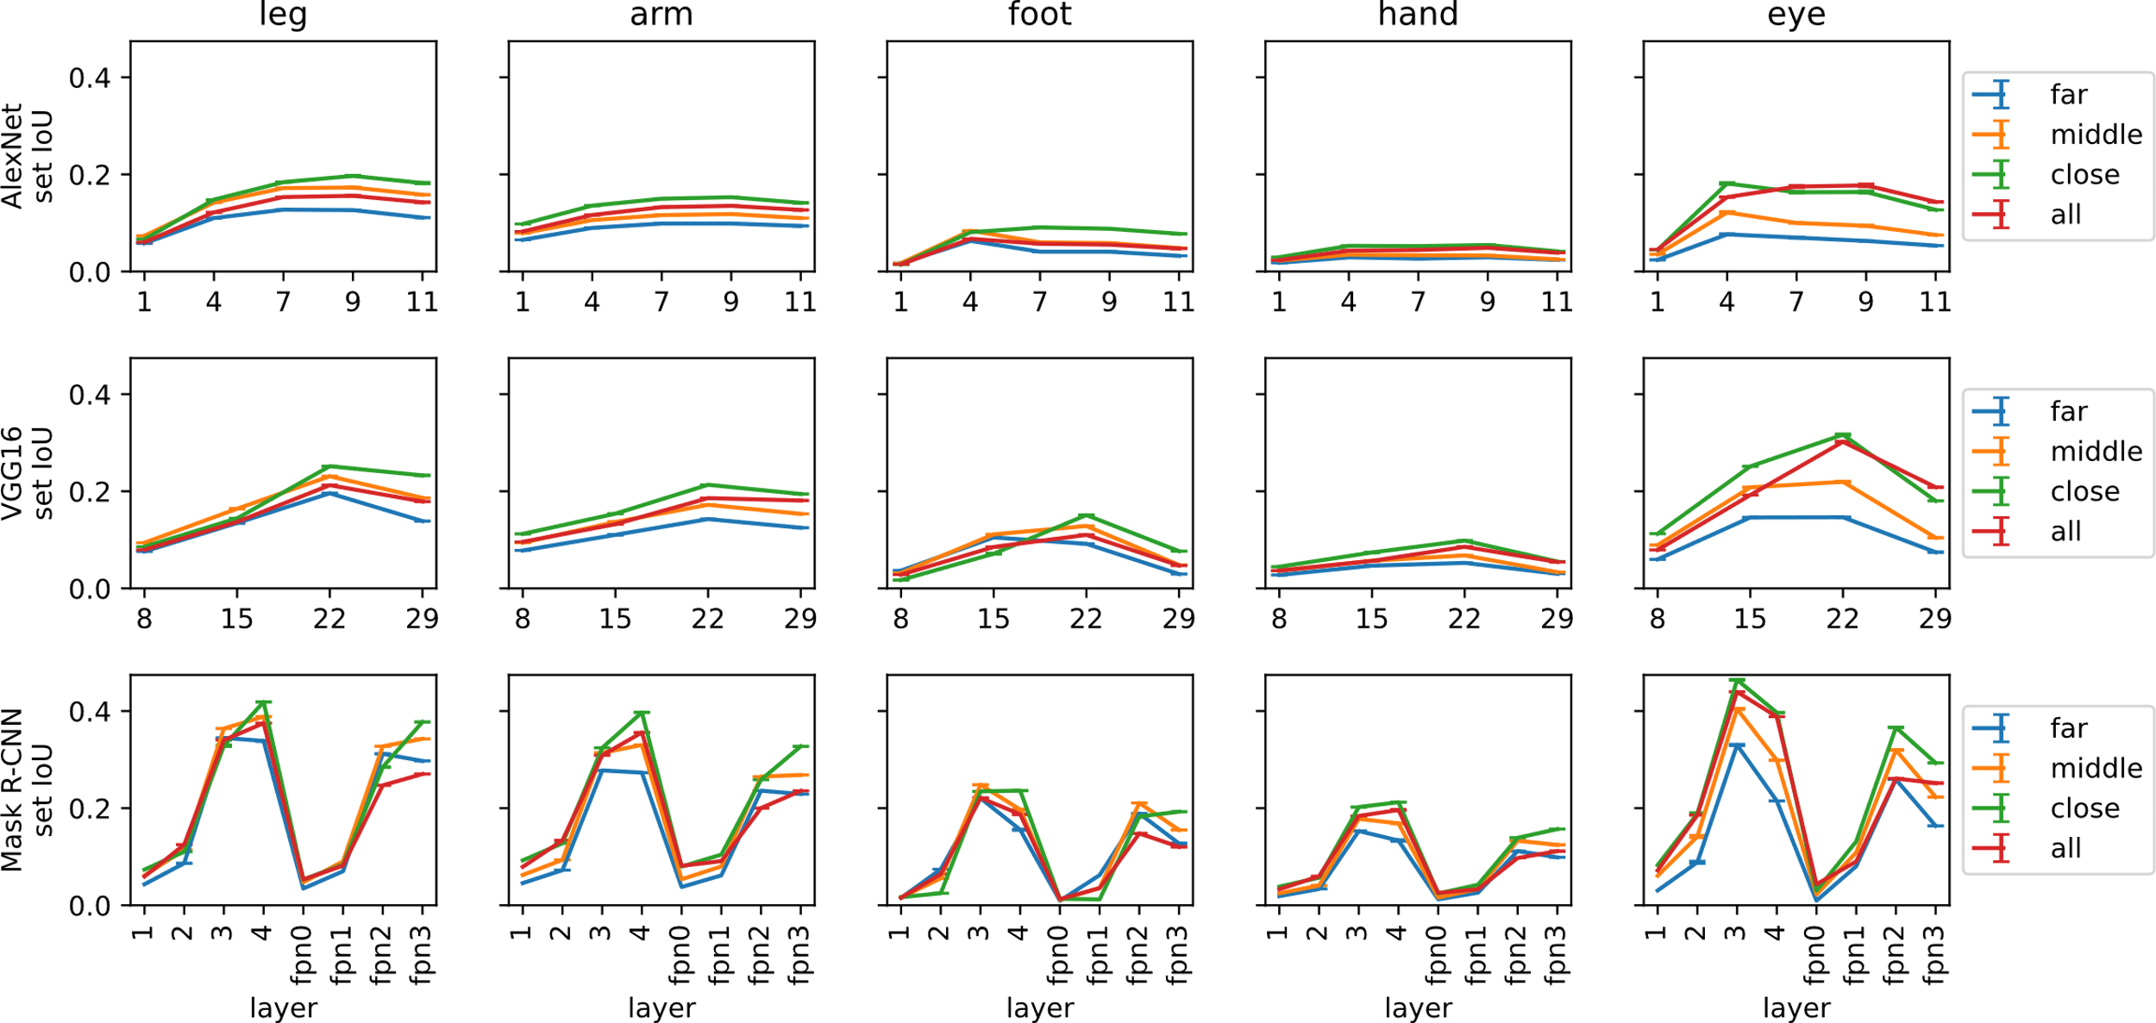
CA for Verification: Size Bias
Emb. strenth
Similarity
Size bias
1.
Notes:
What?
Comparison of set IoU performance per layer, for different models (row), and concepts (left-to-right);
Compared: Test on all data, test on small, middle, large persons
Red: baseline (=all), blue: far, green: close
Interesting:
In general: little difference!
Far < all < close

Slide 21
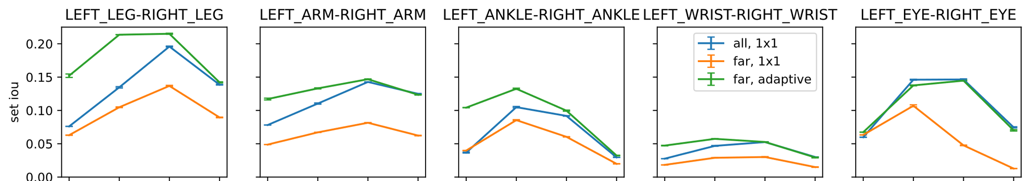
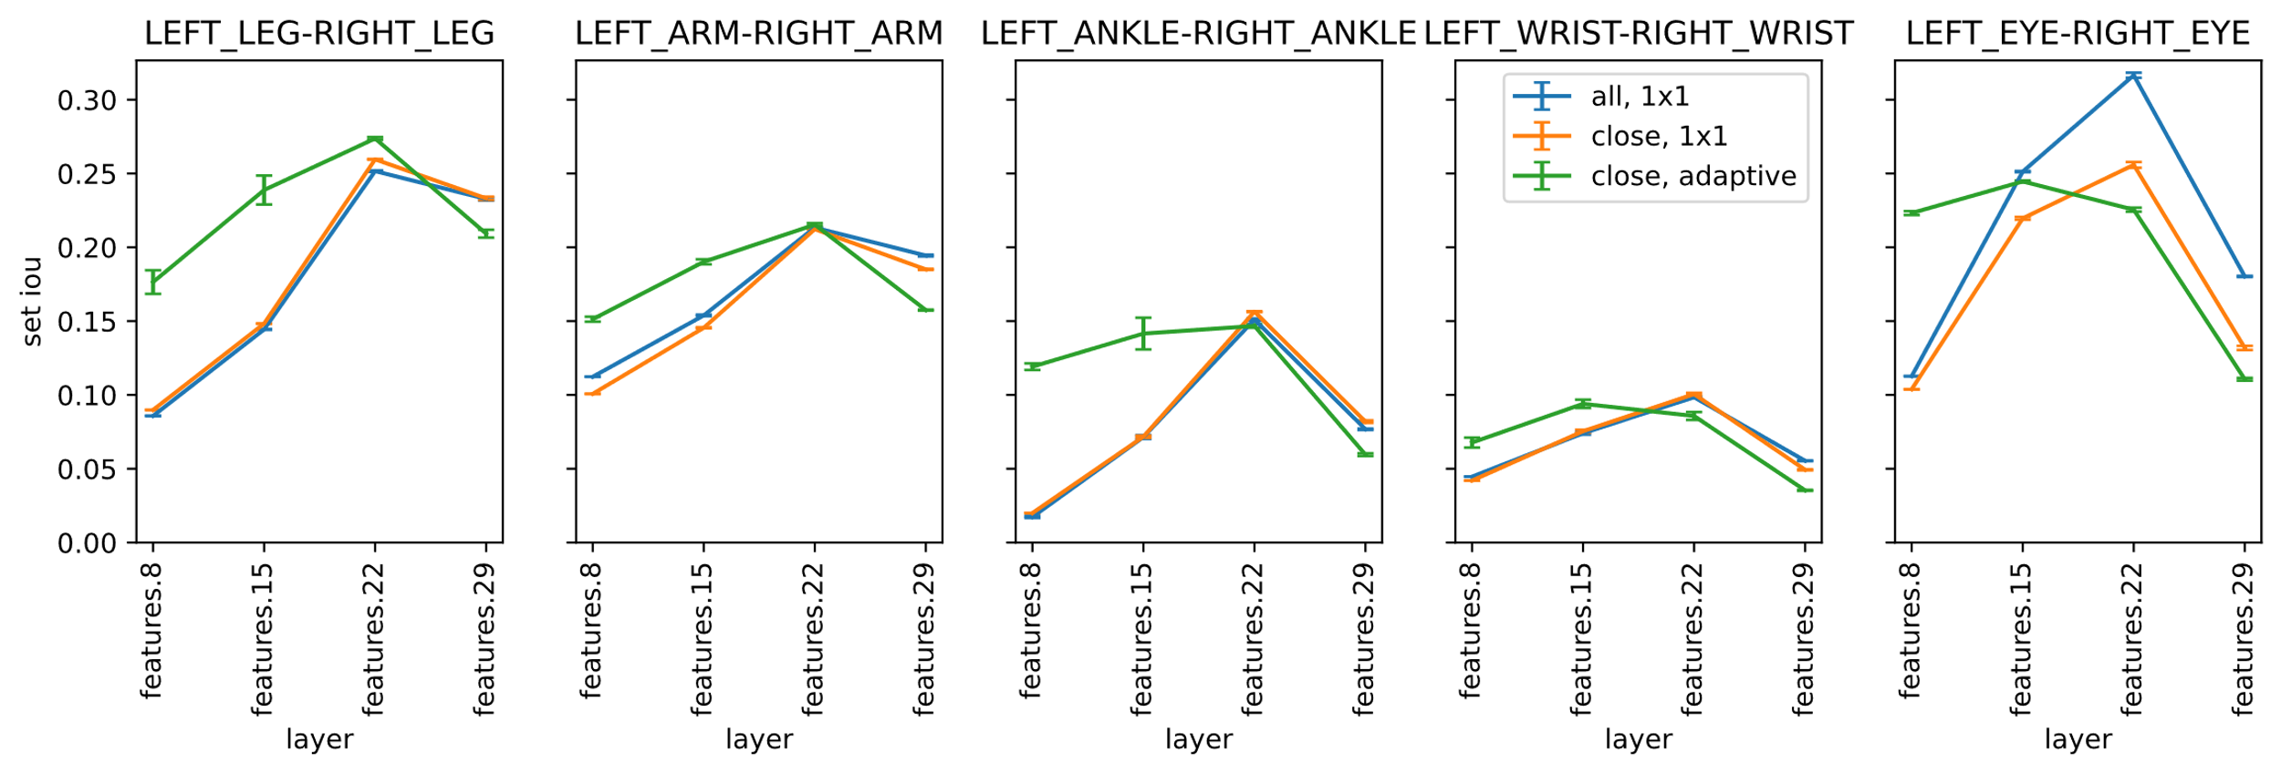
CA for Verification: Size Bias
Emb. strenth
Similarity
Size bias
2.
VGG16 far
VGG16 close
Notes:
What?
Comparison of set IoU performance per layer for different test sub-sets (row), and concepts (col)
Compared: Model trained on all data against models trained on the subset (adaptive and 1x1 kernel)
Interesting:
Adaptive kernel boosts earlier layers, but does not notably change max
Training on subsets even worse than on all

Slide 22
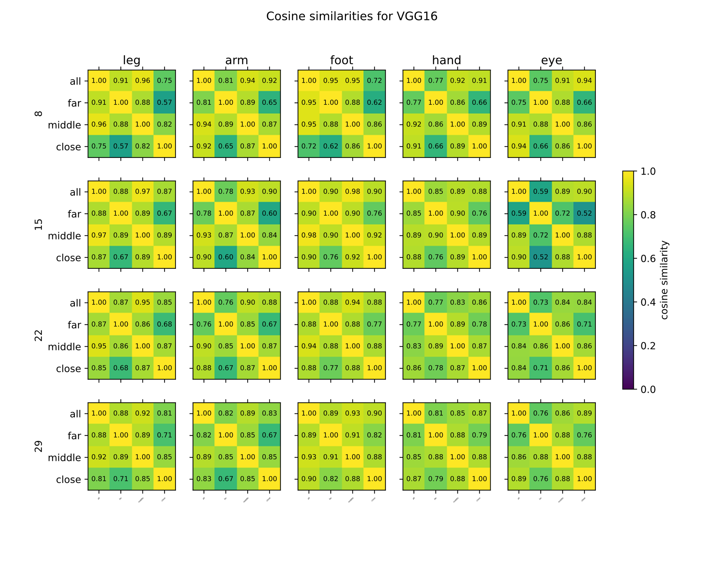
CA for Verification: Size Bias
VGG16:
Notes:
What? Cosine similarities of different size models for different layers (rows), and concepts (col)
Interesting:
Very close, except for eye
Far & close furthest from one another
Higher resolution layers darker = more difference
I also had a look at whether “all” can be represented by linear combination of other vectors
=> no => information gets lost on sub-sets!

Slide 23
Takeaways
Hyperparam. tuning significantly improves Net2Vec
Concept data from keypoint annotations
CA useful for different verification purposes, e.g.
  Embedding strength
  Concept similarity
  Cheap bias checks
  …
Standard nets indifferent wrt. object size

Slide 24
References (I)
Bau, David, Bolei Zhou, Aditya Khosla, Aude Oliva, and Antonio Torralba. 2017. “Network Dissection: Quantifying Interpretability of Deep Visual Representations.” In Proc. 2017 IEEE Conf. Comput. Vision and Pattern Recognition, 3319–27. Honolulu, HI, USA: IEEE Computer Society. https://doi.org/10.1109/CVPR.2017.354.
Fong, Ruth, and Andrea Vedaldi. 2018. “Net2Vec: Quantifying and Explaining How Concepts Are Encoded by Filters in Deep Neural Networks.” In Proc. 2018 IEEE Conf. Comput. Vision and Pattern Recognition, 8730–38. Salt Lake City, UT, USA: IEEE Computer Society. https://doi.org/10.1109/CVPR.2018.00910.
Ghorbani, Amirata, James Wexler, James Y. Zou, and Been Kim. 2019. “Towards Automatic Concept-Based Explanations.” In Advances in Neural Information Processing Systems 32, edited by Hanna M. Wallach, Hugo Larochelle, Alina Beygelzimer, Florence d’Alché-Buc, Emily B. Fox, and Roman Garnett, 9273–82. Vancouver, BC, Canada. http://papers.nips.cc/paper/9126-towards-automatic-concept-based-explanations.
Kim, Been, Martin Wattenberg, Justin Gilmer, Carrie Cai, James Wexler, Fernanda Viegas, and Rory Sayres. 2018. “Interpretability beyond Feature Attribution: Quantitative Testing with Concept Activation Vectors (TCAV).” In Proc. 35th Int. Conf. Machine Learning, 80:2668–77. Proceedings of Machine Learning Research. Stockholmsmässan, Stockholm, Sweden: PMLR. http://proceedings.mlr.press/v80/kim18d.html.

Slide 25
References (II)
Lin, Tsung-Yi, Michael Maire, Serge J. Belongie, James Hays, Pietro Perona, Deva Ramanan, Piotr Dollár, and C. Lawrence Zitnick. 2014. “Microsoft COCO: Common Objects in Context.” In Proc. 13th European Conf. Computer Vision - Part V, edited by David J. Fleet, Tomás Pajdla, Bernt Schiele, and Tinne Tuytelaars, 8693:740–55. Lecture Notes in Computer Science. Zurich, Switzerland: Springer International Publishing. https://doi.org/10.1007/978-3-319-10602-1_48.
Neumann, Lukas, Michelle Karg, Shanshan Zhang, Christian Scharfenberger, Eric Piegert, Sarah Mistr, Olga Prokofyeva, et al. 2018. “NightOwls: A Pedestrians at Night Dataset.” In Proc. 14th Asian Conf. Comput. Vision. Vol. Asian Conference on Computer Vision. http://www.robots.ox.ac.uk/~vgg/publications/2018/Neumann18b/neumann18b.pdf.
Xiao, Tete, Yingcheng Liu, Bolei Zhou, Yuning Jiang, and Jian Sun. 2018. “Unified Perceptual Parsing for Scene Understanding.” In Proc. 15th European Conf. Comput. Vision, Part V, edited by Vittorio Ferrari, Martial Hebert, Cristian Sminchisescu, and Yair Weiss, 11209:432–48. Lecture Notes in Computer Science. Munich, Germany: Springer International Publishing. https://doi.org/10.1007/978-3-030-01228-1_26.
Zhou, Xingyi, Dequan Wang, and Philipp Krähenbühl. 2019. “Objects as Points.” CoRR abs/1904.07850 (April). http://arxiv.org/abs/1904.07850.

