Slide 1
Jhumpa Lahiri, The Namesake (2003)

Slide 2
Discussion questions
1) What are the particular cultural differences that the novel identifies between US-American and Bengali cultures? What are the points of hybridity and hybridization? In what respects does Gogol/Nikhil find himself torn between the two – and how does his relationships with Maxine and his marriage to Moushumi embody the tensions and conflicting forces?
Try to identity – and specifically list – some of the differences.
2) The train crash that almost kills Ashoke lies at the origin of his decision to give his son the pet name ‚Gogol‘. But it also a moment of trauma and – given his silence about it throughout much of the narrative – a largely unspoken point of absence. What do you think the significance of this ‚absence‘ is? What does it reveal about the difficulties that migrants of the first and second generations have in negotiating their relationships with their racial, ethnic, and cultural heritages?

Slide 3
3) Are we the authors of our own identities? And what does it mean when we talk about ‘authenticity’ in identity? What does the ongoing tension between the 'pet name' and the 'good name' have to tell us about identity and subjectivity more generally?
4) What does the novel have to show us about the very concept of 'home'?
5) What is the significance of the Gogol story, ‘The Overcoat’? It barely features in the novel – but why do you think Lahiri chose this narrative in particular?

Slide 4
Race / Ethnicity in the US: the ‘melting pot’
The idea of a ‘melting pot’ society has been central to American concepts of nationality and nationhood since at least the 1780s (the term was popularized in Israel Zangwill’s play of the same name in 1908).
The ‘Melting pot’ model has traditionally aimed to encourage immigrants to assimilate into American culture.
But the melting pot imagery has been challenged by the idea of multiculturalism, the ‘salad bowl theory’, or (a Canadian term) the ‘cultural mosaic’: on these models, immigrants would retain their own national and cultural characteristics while integrating into a new society.

Slide 5
USA: slavery and segregation
Human chattel enslavement, primarily of Africans and African American, was common in C18 and C19 America.
Even by the ‘Declaration of Independence’ in 1776, slavery was still legal in all of Britain’s former 13 American colonies. Slaves made up approximately 20% of the new nation’s population.
Abraham Lincoln won the 1860 election, promising to halt the expansion of slavery. 1860-61, eleven southern states broke away to form the Confederate States of America. This led to the American Civil War, from 1861-5. The Union’s victory was followed by the Thirteenth Amendment in December 1865, which ended the legal practice of slavery in the US.

Slide 6
Slavery and segregation
The ‘Jim Crow Laws’ were introduced by the late 19th Century: continued to be enforced until 1965. Mandated racial segregation in all public facilities in the former Confederacy. Despite the principle of ‘separate but equal’, facilities for African Americans = consistently inferior.
This ‘de jure’ segregation (separation of the races by law) was the rule in the south; in the North, ‘de facto’ segregation (racial separation through informal means) was almost universal. Black people came to live in ghettos (e.g. Harlem, NY) as a result.

Slide 7
Immigration to the US (1900-):
Between 1836 and 1914, an estimated number of over 30 million Europeans migrated to the United States.
The ‘Chinese Exclusion Act’ of 1882 blocked almost all immigration from China until the law’s abrogation in 1943 (in the late 1800s, immigration from other Asian countries became more common).
In 1917, the so-called ‘Immigration Act’ banned immigration from Asian countries other than China, as well as homosexuals, the intellectually disabled, and anarchists.

Slide 8
Immigration to the US (1900-):
The Emergency Quota Act of 1921 limited immigration from the Eastern Hemisphere by introducing national quotas that were equal to 3% of the total number of foreign-born from each nation as recorded in the census of 1910. It was the aim of the Act to further reduce immigration (in general) from S. and E. Europe: particularly Jews and Italian and Slavic peoples.
The Immigration Act of 1924 further restricted immigration – and this was followed by 1952’s Immigration and Nationality Act. Immigration patterns throughout the 1930s were shaped by the Great Depression.

Slide 9
Immigration in the 1960s
In 1965, the Immigration and Nationality Act – also known as the Hart-Cellar Act – absolished national-origin quotas. It equalized immigration policies, giving rise to new immigration from non-European nations and transforming the USA’s demography.
The 1965 bill also lifted the restrictions that had effectively prevented almost all Asian immigration. It also established a preference – for example – for immigrants like Ashima’s husband Ashoke: he (and others) had advanced professional skills that were much in demand at the height of the Cold War against the Soviet Union.

Slide 10
Immigration in the 1960s
The first wave of immigrants frm S. Asia began at the turn of the C20 and included only about 6,400 immigrants.
The 1965 Act triggered a second wave of immigration from India. Those with in-demand technical (and engineering) skills gained precedence: Ashoke’s promise in engineering is what secures his PhD studentship at the Massachusetts Institute of Technology (in Cambridge, MA) in 1968.
The Gangulis are from Calcutta (now Kolkata), which was the first capital of the British rule in India (until 1912). British trade settlements – the originators of colonialism – had begun in Bengal as early as 1685. C19 and early C20 western-educated Bengalis truncated their names (e.g. from Gangopadhyay to Ganguli) to adapt to work in the bureaucracy of the Raj.

Slide 11
Immigration in the 1960s
Nilanjana Sudeshna “Jhumpa” Lahiri (1967-) was born in London, the daughter of Indian immigrants who were originally from the Indian State of West Bengal.
Her father was employed as a librarian at the University of Rhode Island. She and her family would regularly visit relatives in Calcutta.
After a BA from Barnard College (Columbia University), she took an MA, an MFA, and a PhD in English and Renaissance Studies from Boston University (the latter completed in 1997). Since 2012 she has lived in Rome, and she served as professor of Creative Writing at Princeton from 2015 to 2022 (before becoming professor of Creative Writing at Barnard last year).
Her embarrassment over her long ‘given name’ was one of the inspirations behind The Namesake (2003), her debut novel.

Slide 12
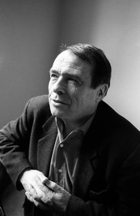
‘Habitus’
Habitus is ‘[t]he cultural framework wherein and whereby the habitual aspects of everyday social thought and action operate. People’s perceptions, thoughts, tastes and so forth are shaped by their habitus.’ –- (Longhurst and others, 2008).
Habitus is a ‘feel for the game’ (Bourdieu): our mastery of the unspoken ‘rules’ of our social and cultural group or circle.
These principles are mediated symbolically in action and are learned through experience. But the power of the dominant classes ensures that their cultural habitus is preferred over others.
Pierre Bourdieu (1930 – 2002)
Source: https://www.goodreads.com/
photo/author/45739.Pierre_Bourdieu

Slide 13
Cultural legacies of slavery
‘Silent Sam’ (at UNC) is topped by protesters, 20 August 2018
Source: https://www.theatlantic.com/politics/archive/2018/08/silent-sam-confederate-monument-unc-chapel-hill/568006/

Slide 14
Black Americans: Cultural challenges to hegemony (i)
The master-slave system was based on denials of black identity, humanity, community, language and history (see Neil Campbell and Alasdair Kean American Cultural Studies: An Introduction to American Culture, p. 85).
‘[T]he truth about a black man, as a historical entity and as a human being, has been hidden from him, deliberately and cruelly; the power of the white world is threatened whenever a black man refuses to accept the white world’s definitions.’ -- James Baldwin, The Price of a Ticket (1985), p. 62.
‘The power to narrate, or to block other narratives from forming and emerging, is very important to culture and imperialism, and constitutes one of the main connections between them.’ -- Edward Said, Culture and Imperialism (1994), p. xiii.
➔ Hence a need for forms of ‘counter-memory’ (as the American Studies scholar George Lipsitz claims)?

Slide 15
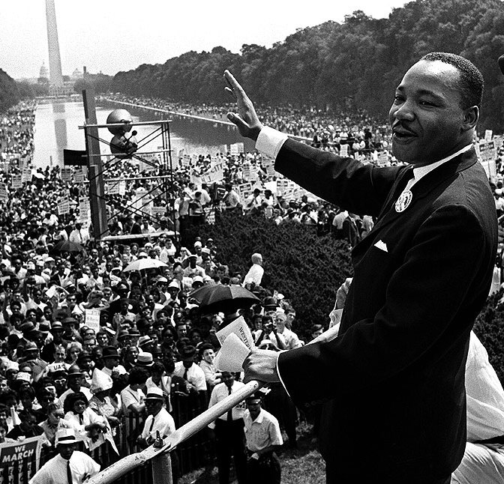
Black Americans: Cultural challenges to hegemony (ii)
The musical tradition: Blues, gospel, jazz, soul, Motown: a fusion of the individual and the communal.
The ‘storytelling’ and preaching tradition: Martin Luther King wove his lyrical political speeches out of biblical, musical, and folk sources.
Contemporary forms of cultural resistance (1980s-): Hip hop as a continuation of forms of individual and collective expression, drawing upon both musical and spiritual resonances.
Martin Luther King delivers his
‘I have a Dream’ speech at the Lincoln
Memorial (28 August 1963)

Slide 16
Exposing and resisting forms of hegemony?
San Francisco 49ers kneel during the national anthem before their game against the Arizona Cardinals,
October 1, 2017. Source: https://gdb.voanews.com/2EB2F2D6-0CC2-4BD6-9539-A34DB5F359BA_cx0_cy9_cw0_w1023_r1_s.jpg.

Slide 17
‘Black Lives Matter’ (2013- )
Members of the Black Lives Matter movement stage a counter-protest
at the Neo-Nazi rally in Charlottesville VA, 12 August 2017.
Source: https://www.washingtonpost.com/graphics/2017/local/charlottesville-timeline/?utm_term=.b0f3b17328bf

Slide 18
The murder of George Floyd: a turning point?
Following murder of George Floyd by the white Minnesota policeman Derek Chauvin on 25 May 2020, cities across the US were rocked by protests – throughout the summer of 2020 – under the ‘sign’ of Floyd’s dying words, “I can’t breathe”.

Slide 19
Image references:
Slide 10: https://www.goodreads.com/photo/author/45739.Pierre_Bourdieu
Slide 11: https://www.theatlantic.com/politics/archive/2018/08/silent-sam-confederate-monument-unc-chapel-hill/568006/
Slide 13: https://www.bpb.de/kurz-knapp/hintergrund-aktuell/267010/martin-luther-kings-i-have-a-dream/
Slide 14: https://gdb.voanews.com/2EB2F2D6-0CC2-4BD6-9539-A34DB5F359BA_cx0_cy9_cw0_w1023_r1_s.jpg
Slide 15: https://www.washingtonpost.com/graphics/2017/local/charlottesville-timeline/?utm_term=.b0f3b17328bf
Slide 16: https://www.bbc.com/news/world-us-canada-52904593

